Slide 1

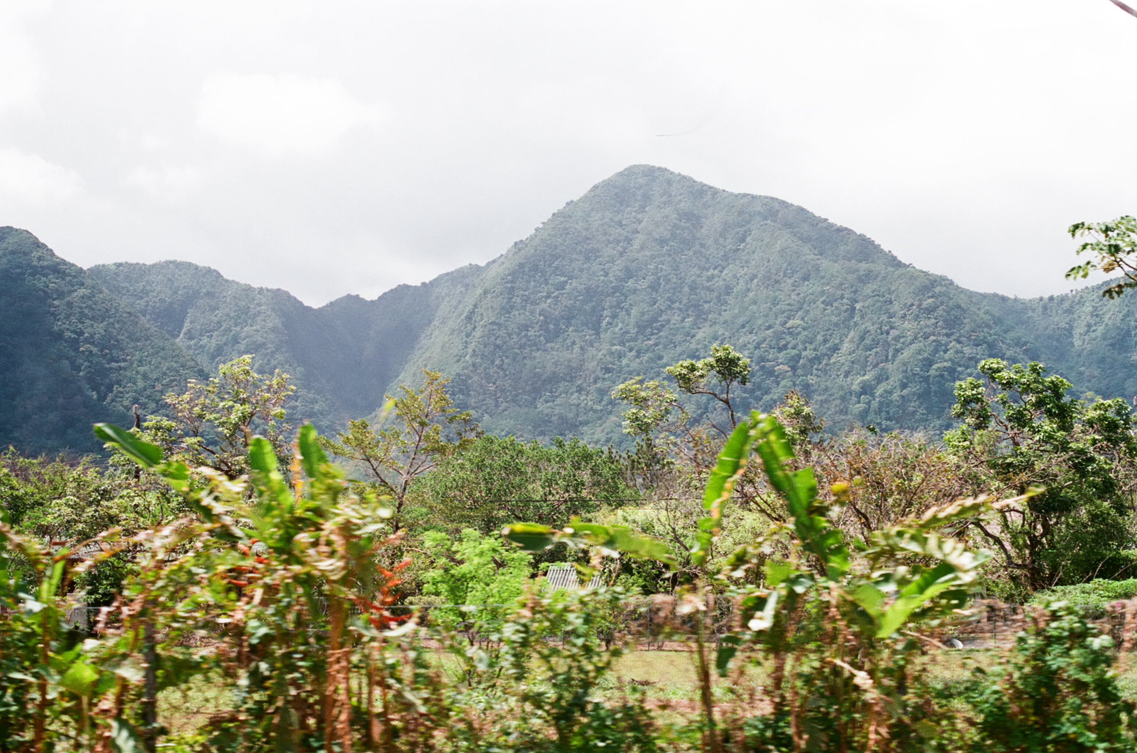
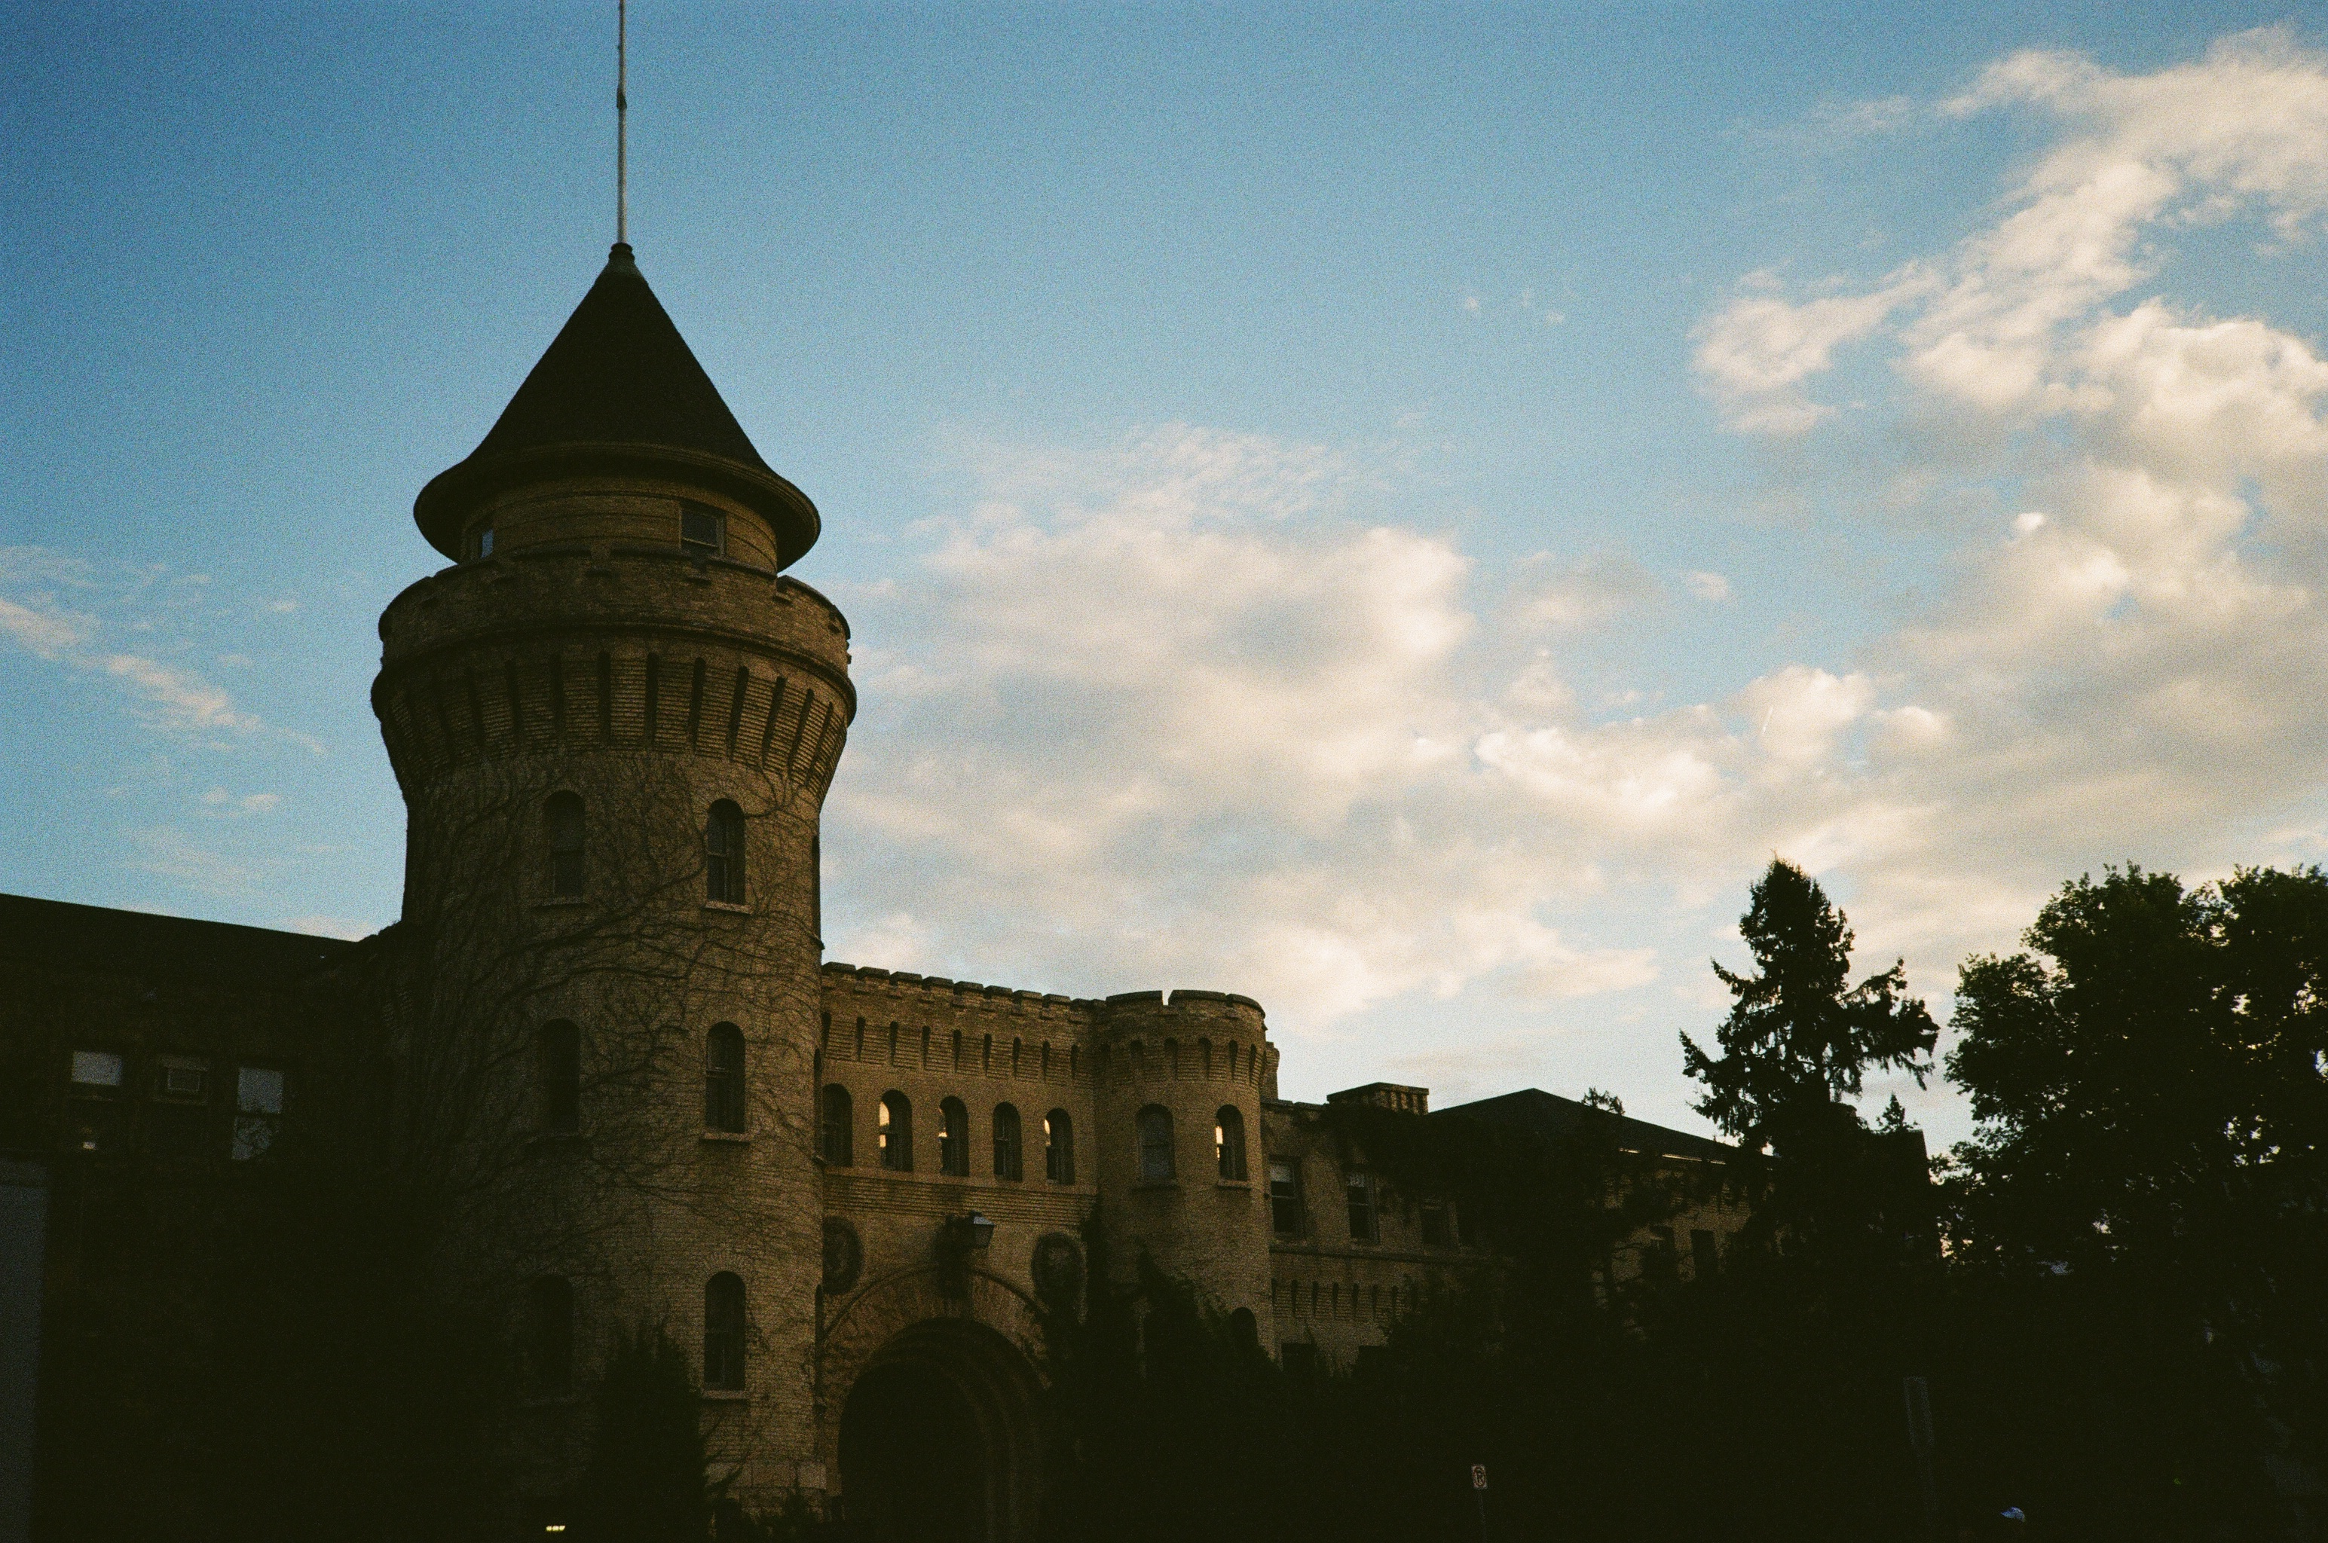
ML Controllers For Quadcopters Nicholas Navarrete

Slide 2
Agenda
Introduction
Simulator
Learning Background
ML Journey
Robustness Testing
Real Testing
Findings
Conclusions

Slide 3
Introduction
Lab
Previous work
Literature
The Gap

Slide 4
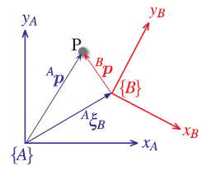
Introduction Lab
VICON Motion Capture system
Built to be used with a Python API
Captures the pose of objects
Does not capture the velocity
Has set frequencies of 30Hz 60Hz 120Hz 240Hz ect.
Has different data streaming modes
Client Pull (what we use)
Server Push
Client Pull Pre Fetch
Notes:
Python offers many advantages, such as a huge number of libraries, robust support, and easy programming but comes with risks related to delays.
The motion capture can only send information in frames! Meaning that we cannot have VICON calculate velocity, we need to manually calculate velocity.
Set Frequencies are a software locked setting, and provide different performance such as accuracy.
Client Pull, the client (the remote computer) sends a request for a frame from the vicon computer and waits for the vicon computer to respond with the most updated frame
Server Push, The vicon computer pushes all frames into a buffer which the client computer reads from. There is a risk of overflowing this buffer.
Client Pull Pre Fetch. Like client pull, except after each pull the vicon computer automatically readies the next frame.

Slide 5
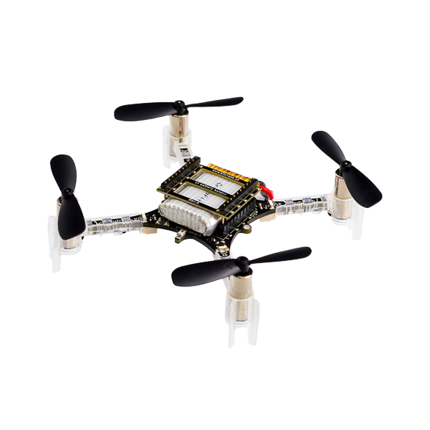
Introduction Lab
Space
20ft x 12ft x 8ft box
Reflective flooring
Quadcopter
Crazyflie 2.X
Vicon Motion capture Pearl markers
Glue
Mount
Notes:
The space the motion capture system can capture, is a 20 by 12 by 8 foot box.
The flooring is reflective, which can cause the motion capture to incorrectly calculate the pose and generally reduce the accuracy of measurements
The pearl markers are IR reflective spheres which are used for vicon to detect.

Slide 6
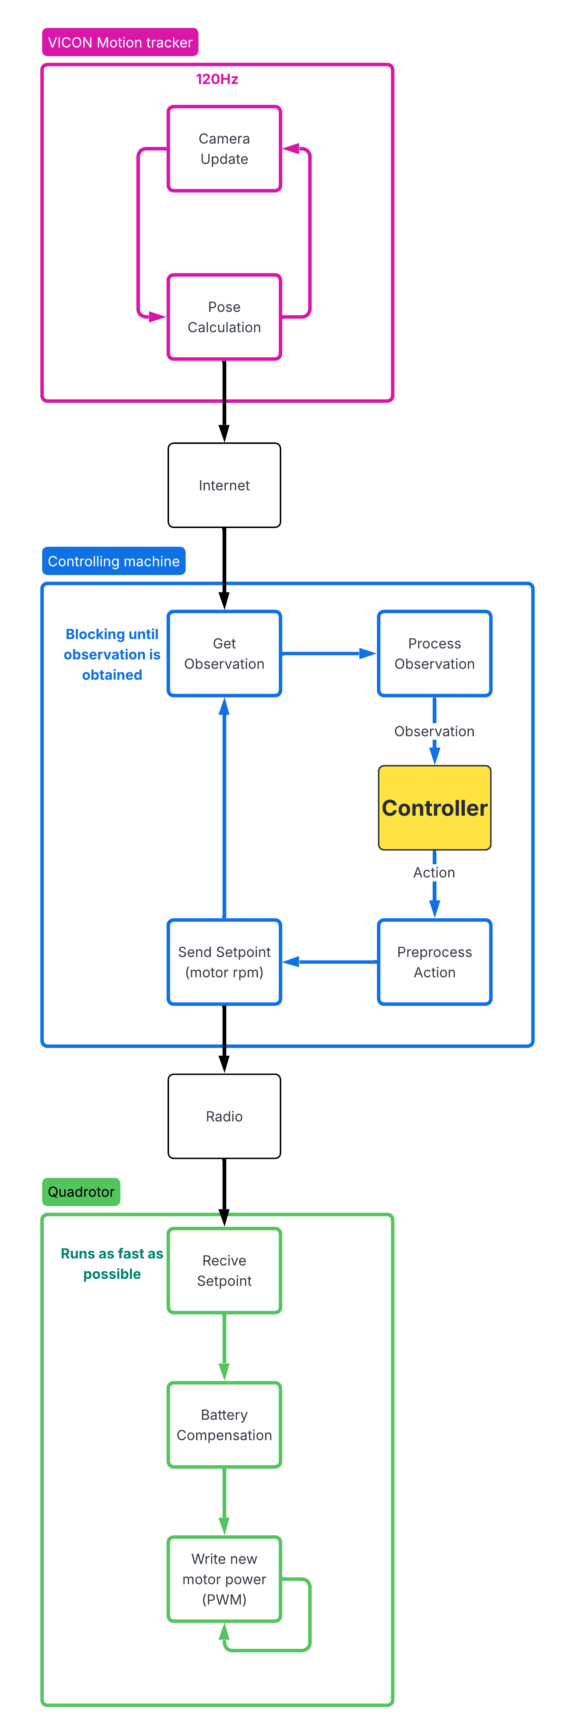
Introduction Previous Work
Using this system at 120Hz and the Marker mount
Cascaded PID control
Trajectory Control
Squares Circles and more
Bulit using Python and a ‘motion capture’ API
Notes:
Previously using the system at 120Hz and mounting the IR pearl markers
A control framework was built using python and a relatively undocumented ‘mocap’ API
Explain briefly the control architecture
We were able to control the quadrotor using cascaded PID, with one controller controlling the attitude and the other controlling the position.

Slide 8
Introduction Previous Work
Senior Design
Controlled the Crazyflie 2.X and VICON Motion capture system
Utilized existing attitude controller
Designed the position controller using classical design methods
Proves that the system is controllable
Notes:
These controllers were somewhat robust to actuator noise and prove that the system is controllable

Slide 9
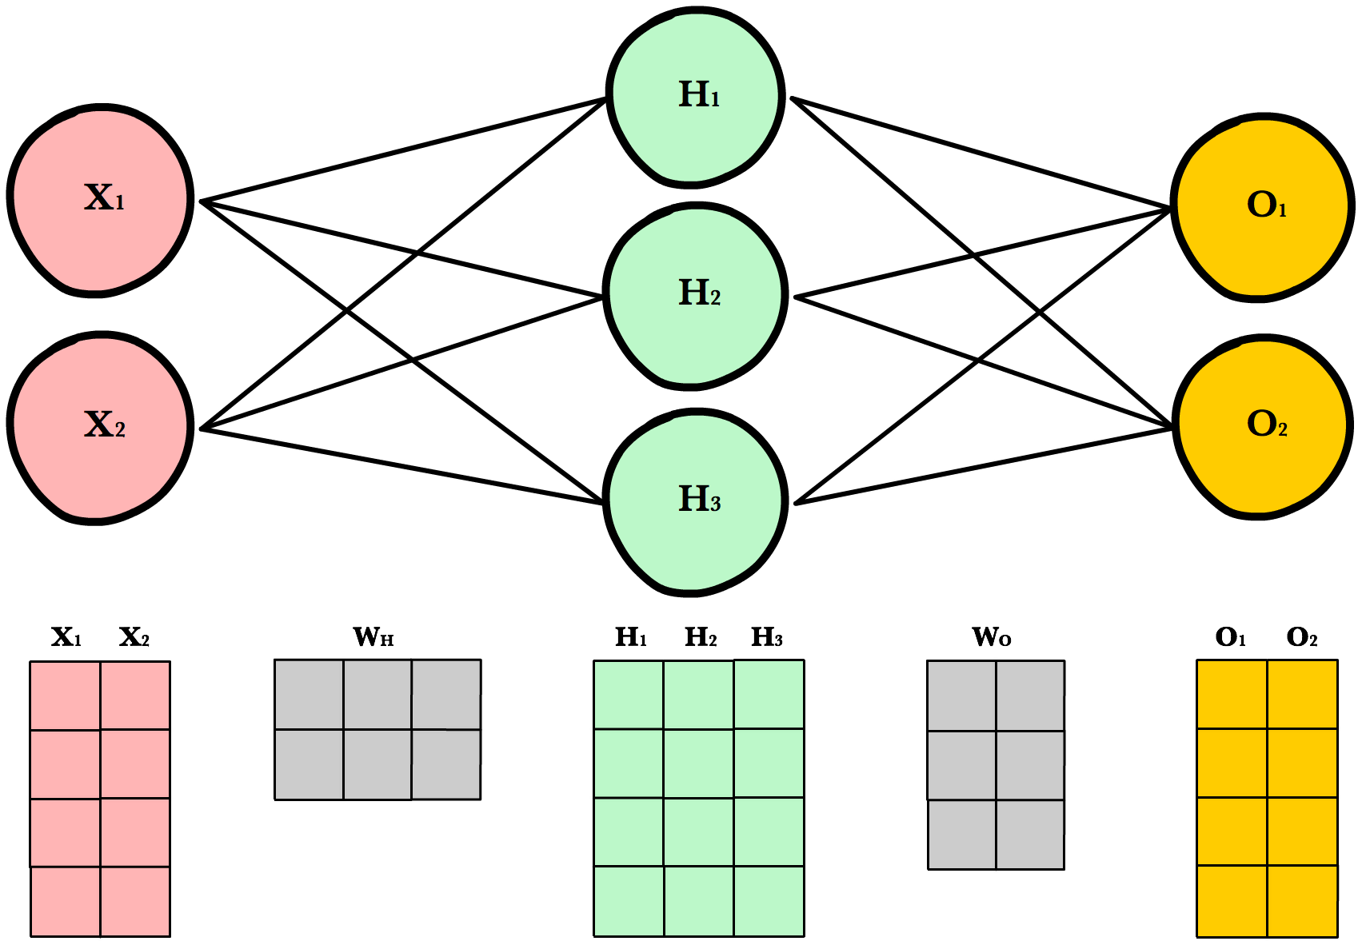
Introduction Literature
Multi-Layer Perceptrons
Simple and fast
Easy to train
Lots of Literature
Cascaded Control
Notes:
Sometimes I will refer to Multi-Layer Perceptrons as ‘MLPs’ or ‘Perceptrons’
They are a very old network, and still offer many advantages:
They are simple type of network and offer a great degree of tractability, and speed which is critical for many different tasks such as control
They are easy to train, as the number of parameters are small and there are many prebuilt libraries that can be used to train them.
There is a lot of literature talking about how MLPS are used for different tasks, one way they are used extensively is in cascaded control for quadrotors

Slide 10
Introduction Literature
Multi-Layer Perceptrons
Trained to either control the attitude or position [3]
Usually they are trained using data gathered from experience [4]
Copying a PID controller or manual
Lose the advantages of a controller designed using optimization
Notes:
These next two slides will cover some of the literature review
In using MLPs for cascaded control for quadrotors:
Each MLP is used to control either the attitude or position, they have not been shown to be capable of direct control. Jack F. Shepherd III and Kegan Turner [3]
To train these MLPs the most common practice is to train them using data gathered from previous experience such as flying the quadrotor either manually or using a controller and then recording the observation and actions, then the MLPs are trained to predict the actions using inputs by copying the recorded data. Dunfied and Tarbouchi [4]
We can lose the advantages of a controller designed using optimization, such as more aggressive maneuvers or increased stability.

Slide 11
Introduction Literature
Model Predictive Controllers
Capable of direct control [5]
Robust to starting conditions
Extremely difficult to implement
Difficulty Training
Harder for future researchers to learn from
Notes:
Model Predictive controllers have been shown to be capable of direct control of quadrotors, but they come with many disadvantages.
They are very difficult to implement
Difficult to train
And hard to learn from (because of their training methods)
So we will not be using them Hwangbo [5]
***********
The work by Edhah and Mohamed [6] uses offline learning to learn a DNN for control, this method was shown to perform similarly to an LQR controller in simulation. Offline learning is especially beneficial for systems which can crash and cause dangerous situations, like a quadrotor.

Slide 12
Introduction The Gap
There is very little research of direct control of a quadrotor using just an MLP
I could not find anything published in journals
There is very little research into the use of direct control MLPs on real systems
There is very little research into “zero shot transfer” learning for quadrotor control.
Notes:
In going through the literature a gap was identified.
There is no published research talking about direct control of a quadrotor using just an MLP trained in simulation
There is no research into direct control using MLPs on real quadrotors
And there is little research into “zeroshot transfer” learning for quadcopter control
This gap is what motivated my research.
The end goal of this was to control a real quadcopter directly using MLPs

Slide 13
Aside on Zero Shot Transfer
Using trained models on datasets that the model has not seen before
Training a model to detect objects in computer generated images vs an image taken in real life.
Training a robot in simulation and then deploying the robot in the real world
Training a controller on a simulated quadrotor then deploying the controller on a real quadrotor
Requires very good training data
Notes:
Zero shot Transfer is broadly defined as using trained models on datasets that the model has not seen before,
Some common examples are training a model to detect objects in CG Images (as is commonly done to create quick datasets) and then using the trained model on real images.
Another example is creating a model to control / path planning for a simulated robot, and then deploying the robot on the real world.
Both examples have the trained models being used on data it has never seen before
In our case a controllers that we create are trained using a simulated quadrotor and then the controller is deployed on a real quadrotor, data it has never seen before.

Slide 14
Simulator
Want it to be compatible with ML Libraries
OpenAI Gym (now called Gymnasium)
PettingZoo
Clean RL
Physics simulator
Bullet
PhysX
MuJoCo
Issac
Gazebo
Notes:
The first step was to find an appropriate simulator.
We need the simulator to be compatible with a wide arrange of machine learning libraries.
Libraries like Gymnasium, PettingZoo, and Clean RL
The simulator should also use a physics simulation engine such as Bullet PhysX MuJoCo Issac or Gazebo

Slide 15
Simulator
Jacopo Panerati and his research group created a simulator!
Uses OpenAI Gym API
pyBullet physics engine
Bonus, it simulates a Crazyflie 2.X quadrotor
The simulator is validated by testing the quadrotor's simulated and real response
Show very similar trajectories when two quadrotors fly “over” each other
Notes:
Jacopo [YA-KOH-POH] Panerati, from the Aerospace Research Centre (Montréal, Québec) of the National Research Council (NRC), and his research group created a such a simulator in 2021.
The simulator is mainly in python, For machine learning libraries, it is already set up using OpenAI’s Gym API which allows us to more easily train the model and modify the simulator
For the physics engine it uses pyBullet, which is the bullet physics engine built for use in python
As a bonus it simulates a Crazyflie 2.x quadcopter, which is the quadcopter I used! The simulator is validated by testing the quadrotors simulated and real response.

Slide 16
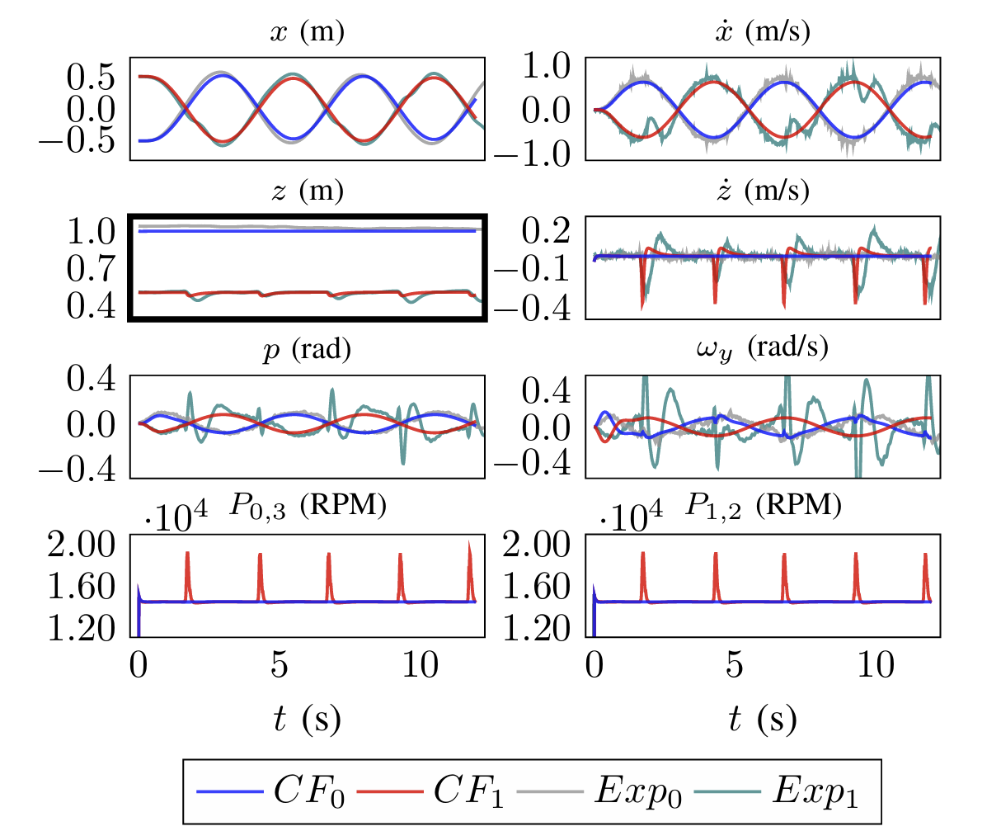
Simulator
Notes:
Here is some testing from Jacopo Panerati between the simulator and real quadcopters,
Red and Blue = simulated quadcopters.
Green and Grey = real quadcopters.
From these trajectories ( specifically the x and z ) we can see that they follow very similar trajectories, they fly at different heights and pass over each other leading to the lower quadrotor being pushed down slightly. Even with such a dynamic event the simulator was able to simulate with reasonable accuracy.

Slide 17
Simulator Modifications
Feedback
Does not model any real feedback system
Assumes perfect pose measurements
Noisy Measurements can be simulated
Delayed Measurements cannot be simulated
Notes:
While the simulator is good, we still need to modify it to be able to learn robust controllers.
Firstly, the feedback of the simulation is perfect. It does not model any real system, and assumes perfect measurements of the quadrotor characteristics like pose.
To simulate the feedback we can simulate “noisy” / “Inaccurate” measurements
We cannot simulate delayed measurements. This is because the simulator requires that the feedback / control frequency is a multiple of simulation steps, so if we vary the control frequency we need the simulation steps to be the LCM of all the possible simulation steps, which requires us to have a massive number of simulation steps, making it impossible to simulate on any computer I have access to.
I characterized the motion-capture system by taking

Slide 18
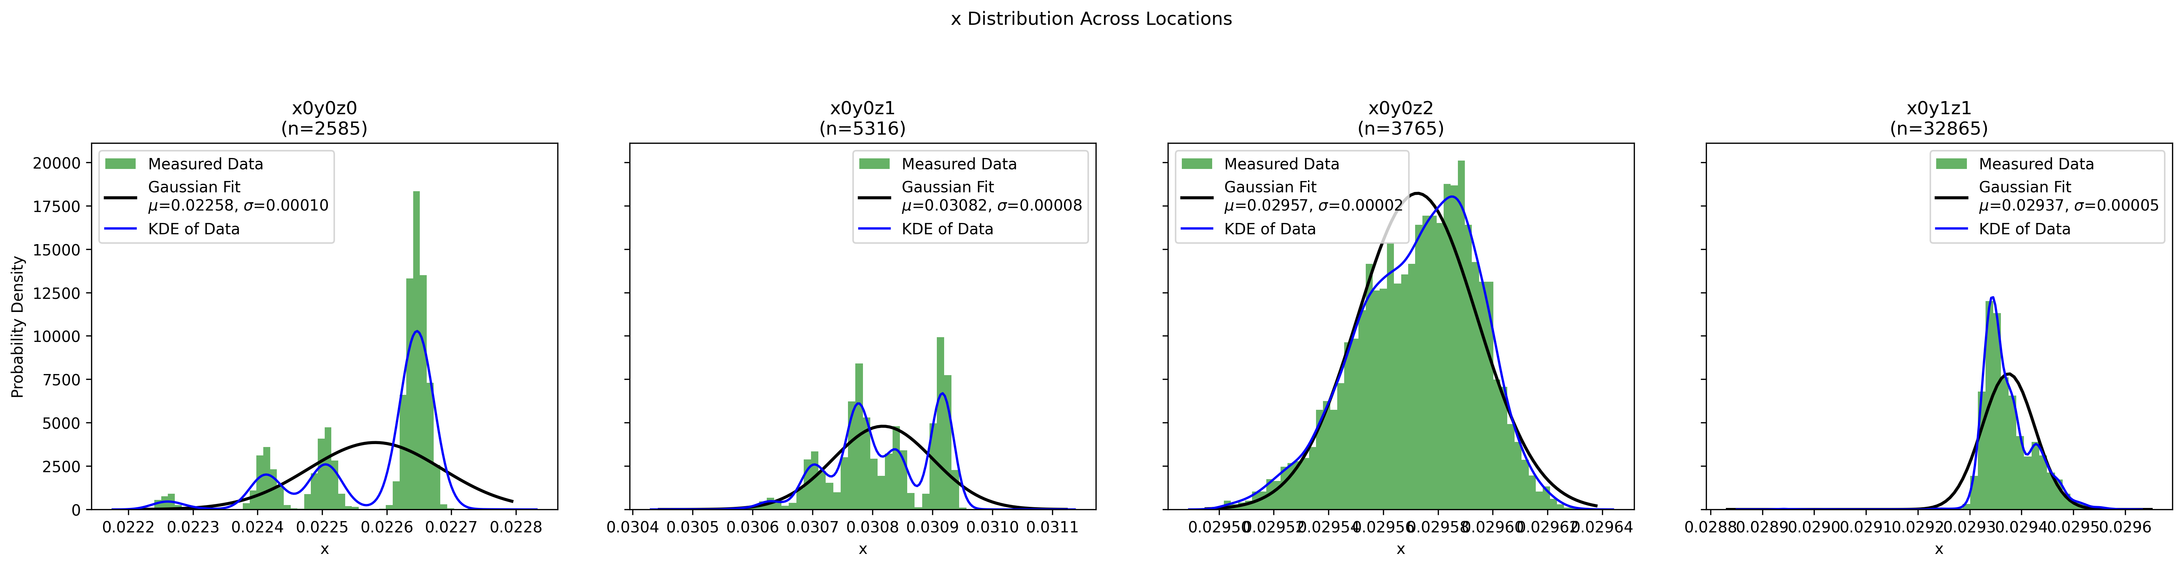
Simulator Modifications
Notes:
Firstly, I aimed to model the motion capture system.
What you see is time independent sets of measurements when the quadcopter was positioned in different locations (point out the locations)
The green data represents the density of measurements ‘n’.
We fit a gaussian onto the data, the gaussian is represented by the black line, which covers the variance of the measurements.
A big question is why do I represent the noise as gaussian? Some of the sets are clearly multimodal (bad).
Well, while some of the data is multimodal, it is likely due to the motion capture system’s tracking of pearl markers causing a few different ‘valid’ estimates of pose.
Because there is no dominant estimates / regimes, the sets have finite variance, and the samples are independent, we can utilize the central limit theorem to create a gaussian representation of the sets. ( from the Lindeberg's condition: https://en.wikipedia.org/wiki/Lindeberg%27s_condition)
**********************************
In statistics, KDE stands for Kernel Density Estimation, a non-parametric technique used to estimate the probability density function (PDF) of a continuous variable, creating a smooth curve to represent data distribution instead of discrete histogram bars. It works by placing a kernel (like a small bell curve) over each data point and summing them up, using a parameter called bandwidth (h) to control the smoothness, helping to visualize underlying patterns in data without assuming a specific distribution.

Slide 19

Simulator Modifications
 | Worst-case variance
X position (m²) | 0.06544
Y position (m²) | 0.09
Z position (m²) | 0.04453
Roll (Radians²) | 0.00189
Pitch (Radians²) | 0.00108
Yaw (Radians²) | 0.00124
The worst-case variance was taken for each datapoint
$$obs={obs}_{real}+Ν(μ=0,σ)$$
Notes:
For each element of the pose of the quadrotor: x y z translations, and roll pitch yaw rotations, the worst-case variance across the different positions was recorded.
This was done for both the 120Hz motion capture system and the 240Hz motion capture system. Comparing the two systems, the slower 120Hz system had an order of less variance than the 240Hz system, as was expected (because the cameras have more time to resolve a better image). So going forwards the whole project is working with the 120Hz system.
The actual implementation of the random variable in the simulation was this sum of the deterministic (so called real) position of the simulated quadrotor, and a zero-mean gaussian of the worst case variance. This is a very simple and reasonably fast implementation for the simulation.

Slide 20
Simulator Modifications
Translational Observations were changed to Errors
Enables flying on a trajectory without increasing the observation space
[ x, y, z, setpoint_x, setpoint_y, setpoint_z]
[ x_Error, y_Error, z_Error ]
$$Error=setpoint−position$$
Notes:
Next I had to introduce translation errors into the simulation. This will enable the quadrotor to follow a trajectory without increasing the observation space.

Slide 21
Simulator Modifications
Action space
Added direct control
Previously only hover rpm ± input
Added thrust coefficient variance
Thrust = KF * rpm^2
This KF is now a guassian with mean 1e-11 and variance of 3.16e-10 which can be changed.
Notes:
The action space of the simulation also had to be modified because previously the simulation only had hover speed and +/- a certain amount
**Note if we need time explain action space**
I will reference hover rpm a few times in this presentation, hover rpm is simply an estimate of the required rpm to produce enough thrust to hover.
The modifications add direct control of the quadrotor, so the input is directly the rpms of the motors, and I changed the coefficient of thrust to be a random variable.
The coefficient of thrust, referred to a KF can be thought of as a gain to the RPM to thrust relationship. Now because the coefficient of thrust is variable the required RPM to produce enough thrust to hover is also variable, meaning that the hover rpm is truly an estimate and is never the real hover rpm.

Slide 22
Simulator Modifications
Observation Spaces
Less memory
[ translation (errors), rotation, velocity (errors), angular velocity ]
More memory
[ translation (errors), rotation, velocity, (errors) angular velocity, average actions, delta actions ]
Notes:
The observation spaces were also modified.
**Note if we need time explain observation space**
I created one observation space which has less memory, which is simply the pose of the quadrotors.
In an effort to increase the amount of memory the controller had ( and in turn maybe learn the true hover rpm ) another observation space had an average of the last actions and the change of the last action added.
The average actions were an average of the last 5 actions
And the delta was difference between the last action and the average of 4 actions before it.

Slide 23
Learning Background
MLPs
Well understood
Have been shown to perform well in control tasks
Notes:
Now we will move on to some quick machine learning background.
My controller / network of choice is the multi layer perceptron.
They are well understood and easily tractable, and they perform well in many control tasks.
Each layer of the perceptron consists of weighted neuron connections and a bias term, followed by a nonlinear activation function. Using a two-layer perceptron with sigmoid activations allows the network to represent nonlinear input–output relationships, including second-order interactions between inputs, which are particularly useful for control tasks.
As a bonus we can measure the rank of the weighted neuron connections and the number of non-zero biases to ensure that each input is being used.

Slide 24
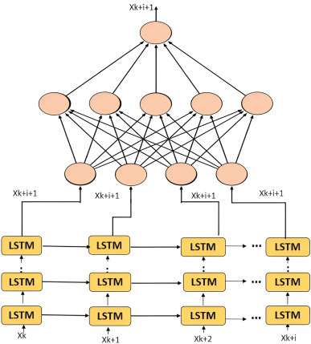
Learning Background
MLPs + LSTM (Long short-term memory)
Slower than MLPs
Have memory built in
Notes:
Another controller architecture I used is LSTM modules with Multi-Layer Perceptrons for feature extraction.
These networks require more computation and are slower to both train and compute when compared to simple MLPs which can be undesirable for faster controllers. But these have memory built into the architecture, which I later show is an advantage for robust controllers.

Slide 25
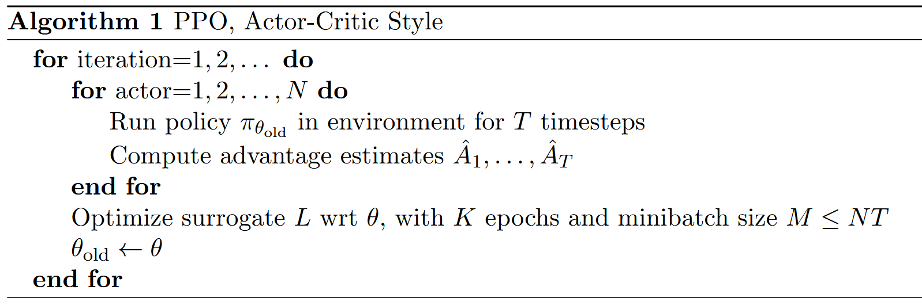
Learning Background
Proximal Policy Optimization
Allows for learning with less tuning of parameters
Avoids Overshoot
Included in many ML APIs
Notes:
For the learning algorithm, I use Proximal Policy Optimization (PPO).
PPO was chosen because it offers several advantages over alternatives such as Deep Deterministic Policy Gradient (DDPG) and Deep Q-Networks (DQN).
First, PPO is relatively robust and typically requires less hyperparameter tuning. Second, it prevents overly aggressive policy updates by constraining the update step through a clipped objective, which acts as a trust-region–like mechanism. Finally, PPO is widely used in current research, resulting in extensive documentation, community support, and well-tested implementations, which is beneficial for reproducible research.

Slide 26
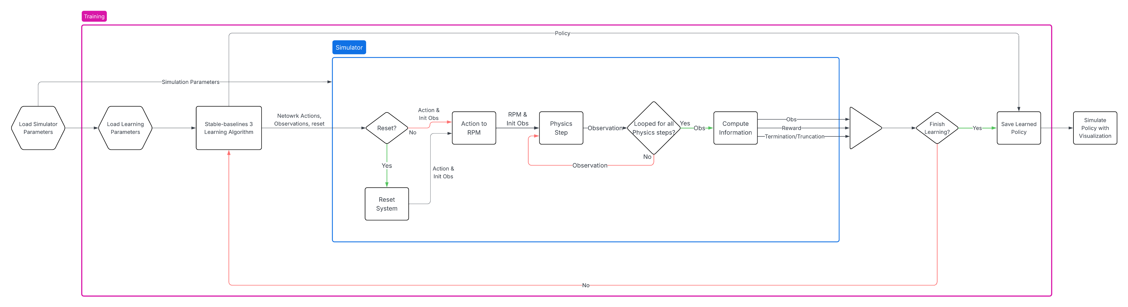
Learning Background
Notes:
Here is a flow chart of how I implemented the learning and the simulator to produce a controller. The actual program is included in my GitHub repository.
Firstly we need to load the simulator and its parameters into an ‘environment’ class. Then we need to load our learning hyperparameters into the SB3 PPO algorithm. This algorithm also initializes the controller.
**Explain as needed for time**

Slide 27

ML Journey
Previously the only reward was:
$$e^{−2∗{\left(z−1\right)}^{2}}$$
Need to update the reward to reward the entire pose
Requires tuning
Notes:
Now we will move on to my machine learning journey. I am calling it a journey because in chasing after a robust controller for direct quadrotor control I had to modify and tune the simulation, this tuning took a lot of time approximately 4 months of tuning and learning, I am only going to present the useful information I learned and not every rabbit hole and dead end.
First on this journey. The simulator had a reward set up, **POINT** this exponential. This reward is only dependent on the quadrotors height and maximizes to 1 at 1m in the air, this works fine if you use the included action space of the simulator. The included action space locked all rotors to spin at the exact same speed without any noise, so it was impossible for the quadrotors to move in the X or Y directions.
A huge amount of work went into finding a suitable reward to reward the entire pose of the quadrotor.

Slide 28
ML Journey
Local optimum
Landing
Throwing itself at the setpoint
Learning times
Training using i5-12500KF CPU and simulating with RTX 4060
Approx 8 hours for MLPs without LSTMs
Approx 12 hours for LSTMs with MLPs
Notes:
In finding the appropriate rewards, I frequently came across two local optimums.
The first local optimum was simply landing the quadrotor, this local minimum existed because the quadrotor was rewarded for keeping the velocity low and the rotations where the need to be (orthogonal?) while accumulating reward for not crashing or fling out of bounds. This was by far the most frustrating local optimum because it plagued many controllers.
The second local optimum was the quadrotor throwing itself at the setpoint and eventually flying out of bounds. This was much more mysterious to me, but I think maybe the drone was collecting rewards early and getting a good advantage estimate.

Slide 29

ML Journey
The updated reward:
$$R_{pos}=e^{{−{Norm}_{2}\left(Target Position−Position\right)}^{2}}$$
$$R_{yaw}=e^{{−0.2∗{Norm}_{2}(Yaw)}^{2}}$$
$$R_{Vel}=e^{{−2∗{Norm}_{2}(Velocities)}^{2}}$$
$$R_{Rotational Vel}=e^{{−0.1∗{Norm}_{2}(Rotational Velocities)}^{2}}$$
$$φ_{Current}=−{Norm}_{2}(Target Position−Position)$$
$$φ_{Previous}=−{Norm}_{2}(Target Position−Last Position)$$
$$R_{Progress}=0.99∗φ_{Current}−φ_{Previous}$$
$$R_{Total}=0.8∗R_{pos}+0.2∗R_{Yaw}+0.15∗R_{Vel}+0∗R_{Rotational Vel}+1∗R_{Progress}$$
Notes:
After a lot of trials, this is the final reward structure that was used to train the different models. It was able to avoid all the local minimums and learn with resasonable time across the different network architectures.
Each state
The main rewards were to the error yaw and velocity. They are essentially the inverse exponential of the 2 norm
The most interesting reward was the progress reward. This reward was included because I struggled greatly with the local minimum of landing. No matter how I tuned the other rewards or simulation parameters there was always a good chance that after learning for hours the quadrotor would only learn to land. I read that similar local minimums were also solved using a progress reward.
This progress reward helped enormously to improve learning because when the quadcopter learns to land, it completely misses out on the progress reward which is a very large component of the total rewards.
The total reward is a sum of the other rewards with weights, you will notice that the rotational velocity remains unrewarded, this is because the final controllers behaved very similarly regardless of the rotational velocity rewards.

Slide 30
ML Journey
SimToReal_61
Add Obs Noise
Add Errors
SimToReal_63
Change observation
PPO_LSTM_10
SimToReal_60
Add Action noise
Change to LSTMs + MLPs
Change action space
PPO_LSTM_11
MEMORY
Notes:
Lastly on the machine learning journey,
Using the massively updated simulation and the new rewards, I created these 5 controllers.
The controllers were created from left to right with more memory being added as I created them. Note that SimToReal_61 comes after SimToReal_60, this is because the original SimToReal_59 was saved incorrectly.
Starting with SimToReal_61, This model has the observation noise from the characterized mocap system, and the observations include translation errors, rotations, velocities, and angular velocity.
SimToReal_60 has the same amount of memory as SimToReal_61, but it adds action noise when training, that is I trained it using KF variance
SimToReal_63 Adds more memory by adding previous actions into the observations, the average of the last 5 actions for each motor and the change between the last action and previous 4 actions. This is a method of adding more memory, because these averages and deltas are metrics for previous actions, aka memory
PPO_LSTM_10 adds more memory by adding LSTM modules to the network while keeping the previous observations, Adding the long short term memory modules includes memory of some previous observations in the network.
PPO_LSTM_11 has the same amount of memory as the previous PPO_LSTM_10, but now with LSTMs we can control the motors directly without an estimate of hover velocity. Previous non LSTM models were unable to control the quadrotor without estimates of hover velocity

Slide 31
Testing Robustness
Robustness to what?
Action noise vs observation noise
We will use action noise
Varying the coefficient of thrust at the start of every simulation
Represents inefficiencies and external forcing
Indirectly changes the hover rpm
Notes:
Now that I created this model, I need a way to empirically test their robustness in order to compare them.
Robustness can be tested in many ways; some common ways are to test the robustness to either action or observation noise. I characterized the observation noise, but it is incredibly hard to characterize the action noise for such small and cheap motors and propellers, so I think it is more useful to test for robustness to action noise.
At the start of every simulation, I can change the coefficient of thrust for each individual motor. The coefficient of thrust is represented as a gaussian RV for each individual motor, and across the simulations I can change the variance of the random variable.
This helps to represent inefficiencies such as damaged propellers and motors, or external forcing such as wind.
Super important to note, by changing the coefficient of thrust we are changing the actual hover rpm, that is the rpm needed to hover the quadrotor. The controller includes an estimate of hover rpm, but that estimate gets worse as the variance is increased.

Slide 32
Testing Robustness
We can create multiple simulations and measure when the simulation ends from timeout or termination (crashing, out of bonds)
Measure the rate of success over various simulations while varying the ‘KF variance’
Rate of Success = (Timeout count / (Termination count + Timeout count)
Notes:
The actual robustness test is to vary the variance of the coefficient of thrust and measure the success rate.
We can do this by creating multiple simulations and measuring when a simulation ends from either time out or termination. Simulations terminate after crashing or flying out of bounds.
We can measure the number of terminations and timeouts over many simulations while varying the kf variance. Then for each value of KF variance by taking the number of timeouts over the total number of simulations.

Slide 33
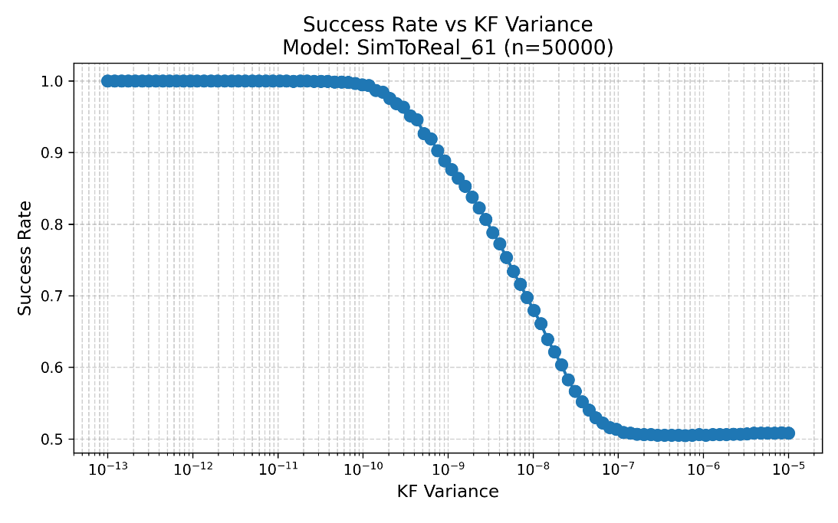
Testing Robustness
Model: SimToReal_61
Trained without KF variance
Reward: 2757
Notes:
Here is the success rate for the first model, SImToReal_61.
This is one of the MLP models with no memory and it is trained without any KF variance. It is important to remember that the actual coefficient of thrust is 3.16e-10 and it is shown here that at about 1e-10 the model begins to fail to control the quadrotor and the success rates begins to fall to 0.5 at around 1e-7

Slide 34
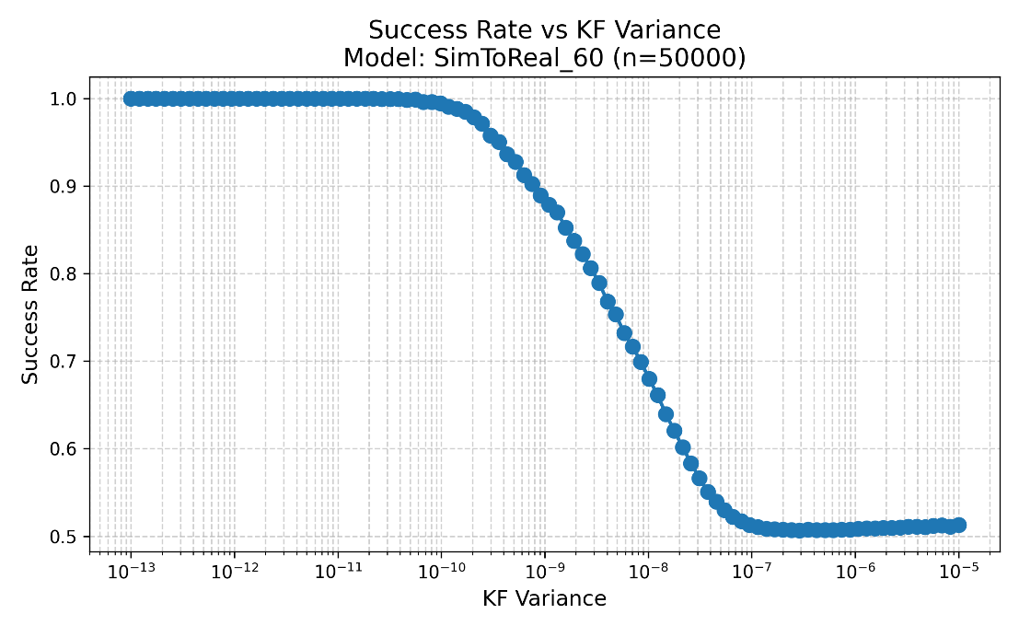
Testing Robustness
Model: SimToReal_60
Trained with KF variance
Reward: 2139
Notes:
This next model SimToRal_60 also has no memory but is trained using a KF variance of 1e-11. The result is a controller which is practically equally as robust as the one trained without variance. The only real difference. is at about 3e-10 where you can see a very small improvement, but not enough to be significant

Slide 35
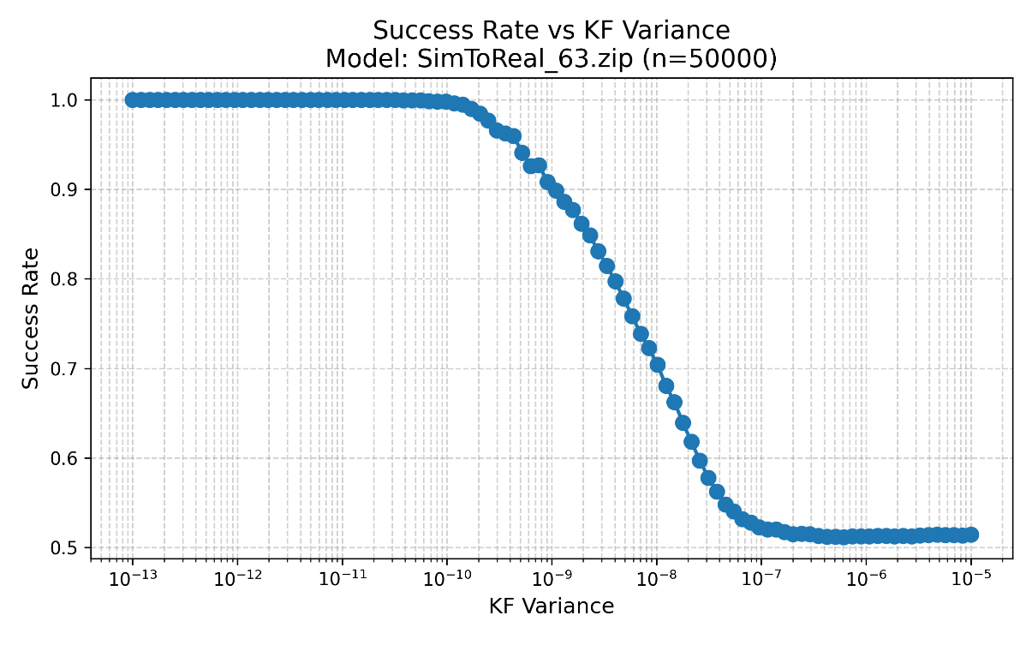
Testing Robustness
Model: SimToReal_63
Trained with KF variance
New Observation (Includes last actions)
Reward: 2676
Notes:
SimToReal_63 was the MLP with the new observation which includes metrics of the last actions and observations. This is the first model with introduces a form of memory and the success rate is visibly better across the variance of 1e-10 to 1e-7.
**Flip between slides**

Slide 36

Testing Robustness
Model: PPO_LSTM_10
Trained with KF variance
New Observation (Includes last actions)
Reward: 3282
Notes:
Now we arrive to the first model using LSTM modules. These LSTM modules allow for the network to remember last observations and take them into account. Increasing the amount of memory the controller has because now it has memory of the last actions (built into observations) and memory of all previous observations.
The success rate graph shows about the same performance between the last model and this model, with some improvements in the higher end of variance and some worsening on the higher end.

Slide 37
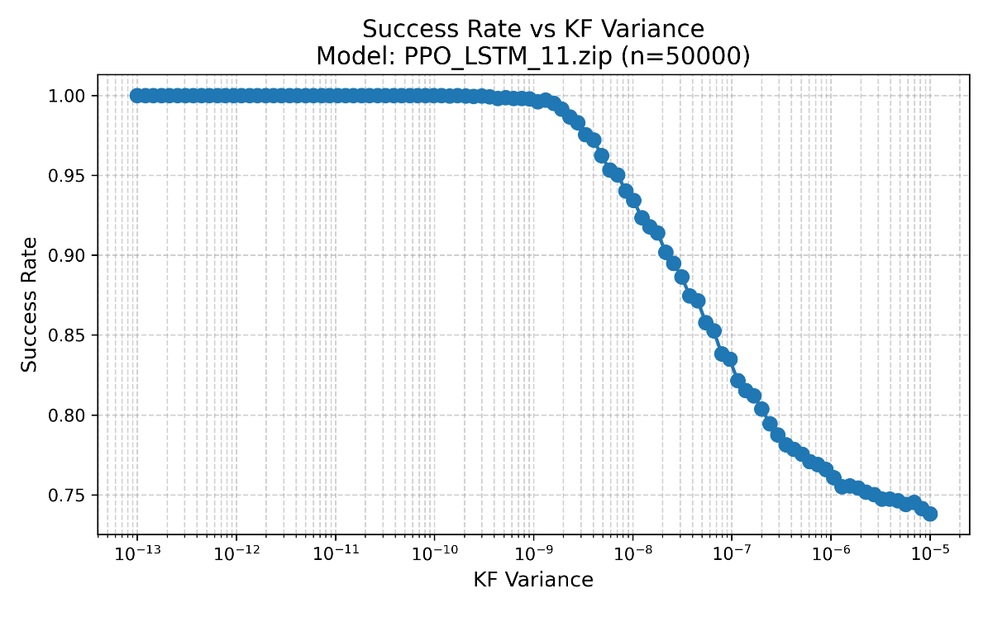
Testing Robustness
Model: PPO_LSTM_11
Trained with KF variance
New Observation (Includes last actions)
New Actions (No hover rpm)
Non-LSTM models cannot control this action
Reward: 3134
Notes:
Lastly PPO_LSTM_11 has the same layers as PPO_LSTM_10 but now has the updated action space.
The new action space is the same one described earlier where there is no included estimate of the hover rpm, and 0 correlates to no power and 1 to max power to the motors.
None of the MLP networks without LSTM modules were able to control the system without the hover rpm estimate. (Believe me I tried A LOT to get them to work but they could not learn to fly without impractically fine tuning the ML).
This dramatically improved the robustness when compared to other models, likely because the controller can fly the entire range of the motor rpms to compensate for variablity

Slide 38
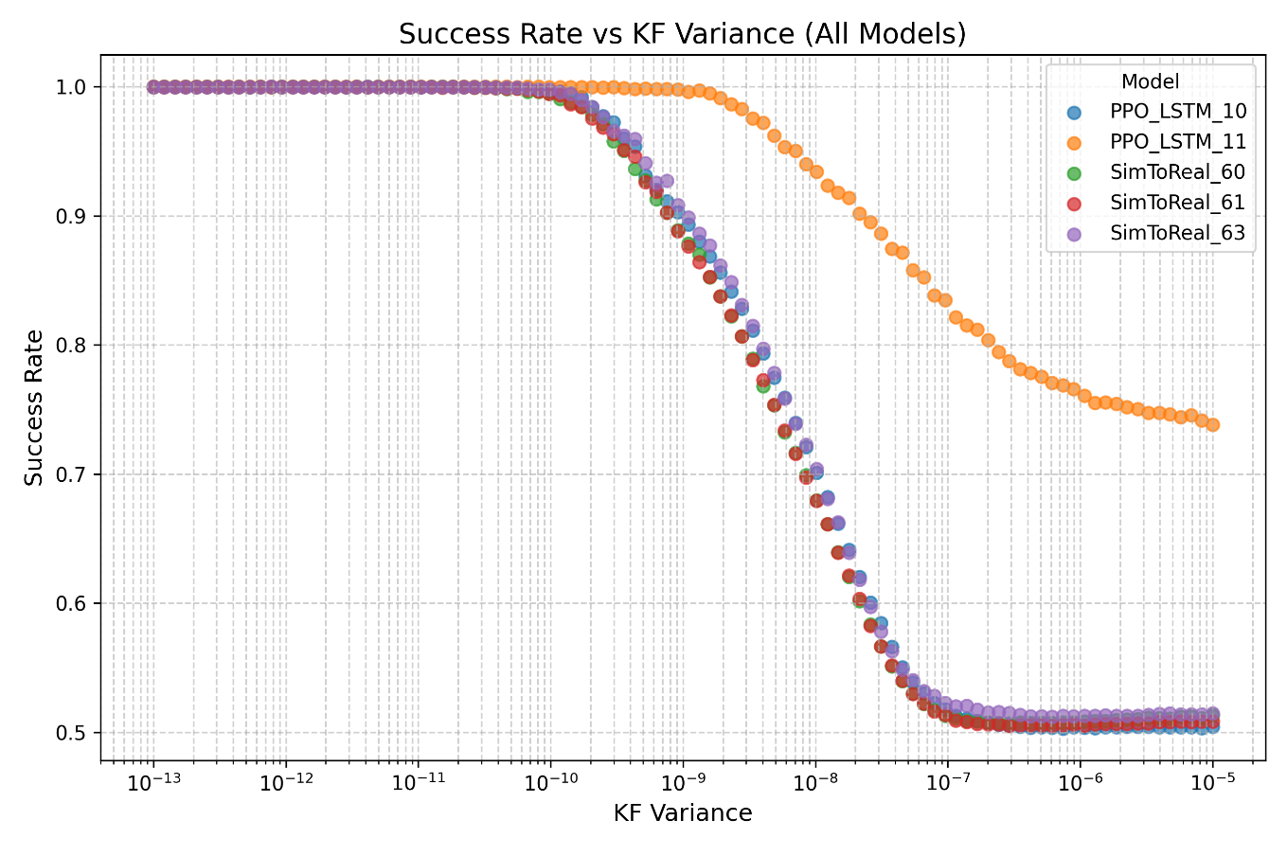
Findings
Notes:
Here I have combined the success rate for all 5 different models, we can see here that the red and purple MLP models have approximately the same success rate, the models with memory have a higher success rate compared to the previous MLPs, SimToReal_63 and PPO_LSTM_10 have approximately the same success rate.
PPO_LSTM_11 has a new action space of control without the estimate of hover velocity, and as a result there is a dramatic improvement in robustness. Success rate only begins to fall after one whole order of magnitude greater of motor variance.

Slide 39
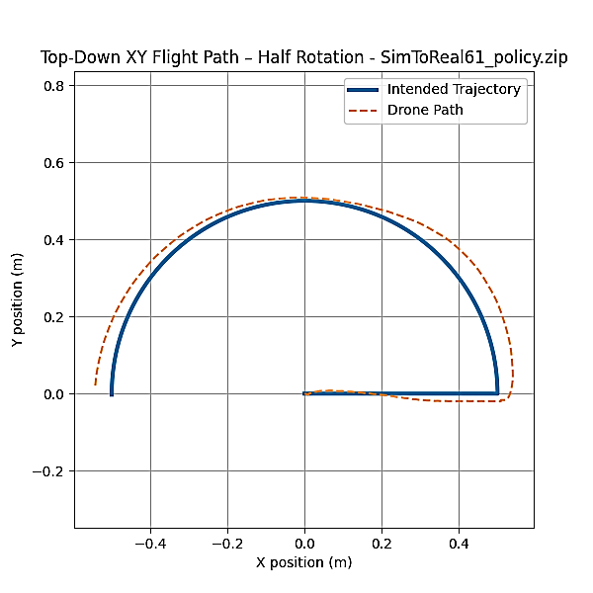
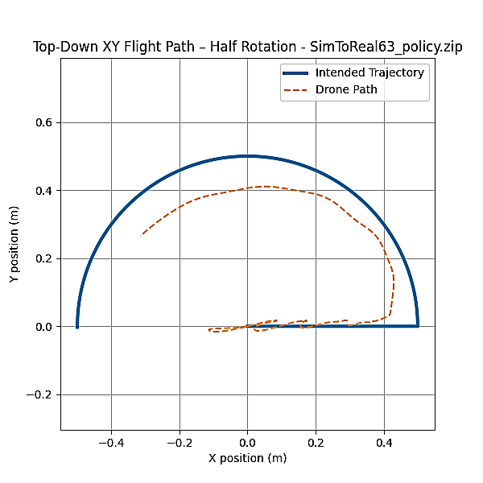
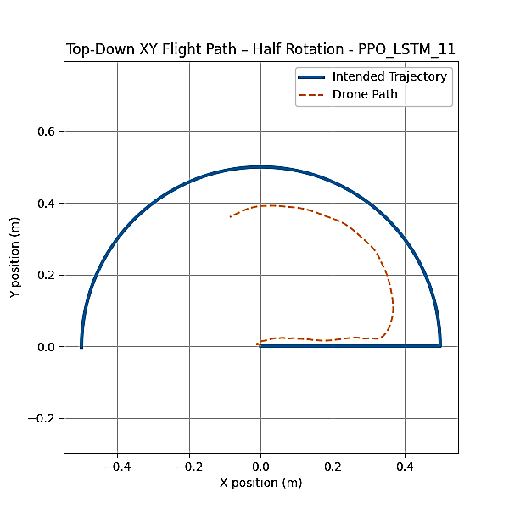
Findings
Notes:
Here are three trajectories each one being controlled by a different model.
The leftmost trajectory is controlled by SimToReal_61, this is the same model which has no memory, It flies very quickly, keeping up with the blue trajectory and this is to be expected with optimal controllers.
The middle trajectory is controlled by SimToReal_63, this model has more memory than Sim To Real_61, it flies a bit slower than the previous controller and has some jittering
The rightmost trajectory is controlled by PPO_LSTM_11, this model has more memory than the previous model, it flies much slower than the first controller, though it does not have the jittering of SimToReal_63.
**Mention that I have the trajectories of the other 2 models.

Slide 40
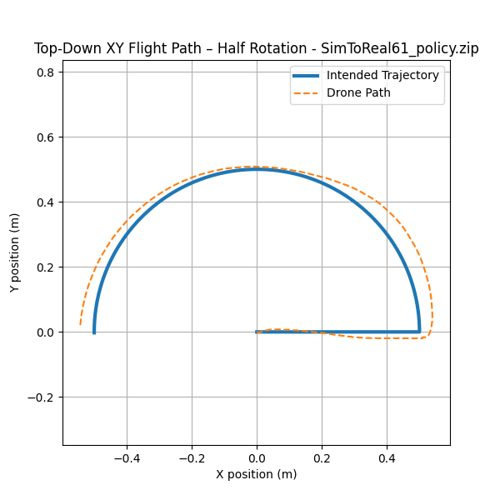

Slide 41
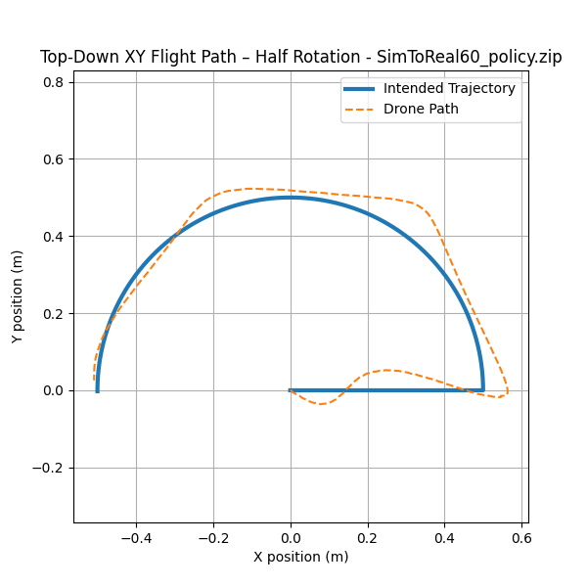

Slide 42
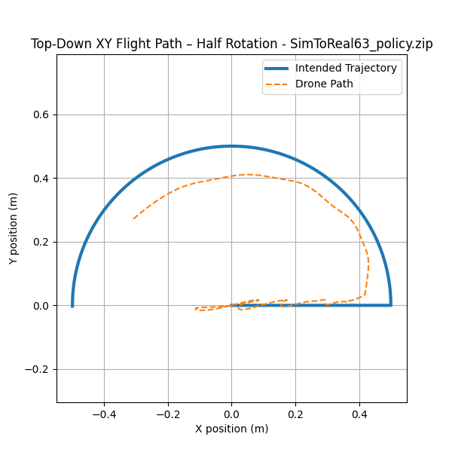

Slide 43
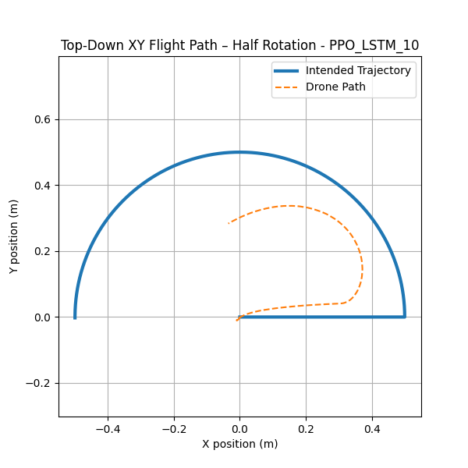

Slide 44
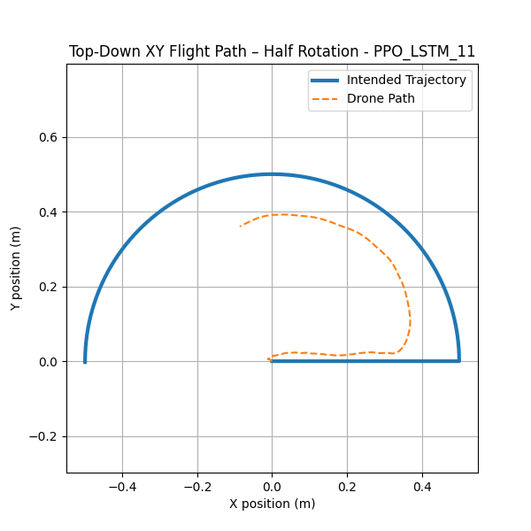

Slide 45
Real Testing
Each model was tested and troubleshooted to ensure proper functionality
Models SimToReal_60, SimToReal_61, SimToReal_63, PPO_LSTM_10 Require hover velocity estimates.
Calculated by recording the thrust when hovering using a PID controller
Tests started the quadrotor by both dropping, and on a tripod 1 meter in the air
None of the models were able to control the real quadrotor
PPO_LSTM_11 did come the closest
Notes:
This thesis originally set out to fly and test these models on real quadrotors.
I had to extensively update the real system in order to test the models. I needed to update the firmware for the quadrotor to receive radio commands which encode motor power. The controlling program was also changed to accept neural network control and create the observations from the motion capture data.
The models **S2R60 61 63 and LSTM 10** all require the estimate of Hover RPM. I obtained this estimate by flying the quadrotor using cascaded PID control. I made the quadrotor hover 2 meters off the ground to avoid ground effect, then I recorded the average commanded thrust. This changes as the battery voltage changes! So for every trial I ensured that the battery was fully charged.
I extensively tested and troubleshooted troubleshot? The system to ensure that the controller and different models were all playing well together, but in the end none of the models were able to control the real quadrotor. I event went as far as grabbing a tripod and ensuring that the initial conditions were the same as simulation. That being said, PPO_LSTM_11 looked to be the closest to actually flying but it is super hard to measure empirically.

Slide 46
Conclusions
This research resulted in the development of new research software, firmware, and tools.
Firmware for direct remote control of the Crazyflie 2.X rotors
Huge Improvements to the simulator
Tools to test different models
Success Rates
Software to test the motion capture system
Software to fly a real Crazyflie 2.X using VICON motion capture system.
All these developments will be posted on GitHub for future research into shortening the Sim To Real Gap
Notes:
To conclude all of the work and research I have done. One very important product has been the software, firmware, and tools that I have developed in research.
Talk about the different sub points

Slide 47
Conclusions
Proved that a Crazyflie 2.X can be controlled directly and follow trajectories using MLPs
Proved that by increasing the memory of the controller (Observation or Architecture) we increase the robustness of the controller to actuator noise
Proved that unlike controllers with just MLPs, LSTMs with MLPs can directly control a quadrotor without estimates of ‘hover rpm’ and that such a controller was greatly more robust than ones using an estimate.
Notes:
Now for the conclusions that I think are more important.
I proved that multi layer perceptrons that were trained by rewarding pose were capable of controlling quadcopters directly and following trajectories. This is an important point, because previous published research only used multi layer perceptrons that were trained by rewarding actions that were similar to actions taken by classical controllers.
By increasing the memory of the controller, either by changing the observations to include some metrics of previous actions or by changing the architecture. We Increase the robustness to actuator noise.

Slide 48
Thank you! Questions?

